Slide 1
Introduction to Power BI
By: Sakina Neemuchwala

Slide 2
What is Power BI?
Power BI is a Business Intelligence (BI) and Data Visualization tool developed by Microsoft.
It allows users to connect to data sources, transform and analyze data, and create interactive dashboards and reports that provide actionable insights.

Slide 3
Components of Power BI
Component | Description
Power BI Desktop | A Windows application to create reports and data models. Used by data analysts.
Power BI Service | An online SaaS platform to share, publish, and collaborate on reports.
Power BI Mobile | Mobile app for accessing reports on the go.
Power BI Gateway | Bridges on-premises data with Power BI cloud services.
Power BI Report Server | For hosting reports on-premises instead of the cloud.

Slide 4
Key Features
Data Connectivity – Connect to various data sources
Data Transformation – Clean and shape data
Data Modeling – Use relationships and DAX
Visualizations – Charts, maps, cards, etc.
Interactivity – Filters, drill-downs, tooltips
Real-Time Dashboards – Streaming data
Sharing and Collaboration – Share reports securely

Slide 5
Power BI Workflow (ETL Pipeline)
Extract
Extract – Import data from sources
Transform
Transform – Shape data using Power Query
Load
Load – Load data into model
Visualize
Visualize – Create reports and dashboards
Share
Share – Publish using Power BI Service

Slide 6
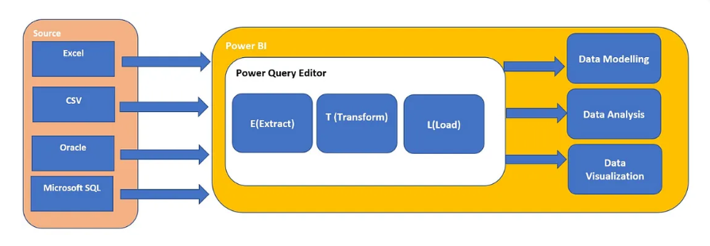
ETL Process Diagram

Slide 7

Common Use Cases
Sales and Marketing Dashboards
Financial and Budget Analysis
HR and Employee Metrics
Customer Behavior Tracking
Operations and Inventory Management

Slide 8
Power BI vs Excel
Feature | Excel | Power BI
Designed For | Spreadsheet Calculations | Data Analysis and Visualization
Visuals | Static or manual | Interactive and dynamic
Data Size | Limited | Handles large datasets
Collaboration | File-based | Web-based sharing

Slide 9
Learning Path
Basic: Data import, types, visuals
Intermediate: Relationships, DAX, filters
Advanced: Row-level security, parameters, advanced DAX

Slide 10
Understanding the Power BI Ecosystem:
These are the three core parts of the Power BI ecosystem, each with a specific purpose in the BI workflow.
Power BI Desktop
Power BI Service
Power BI Mobile

Slide 11

Power BI Desktop – The Report Creator
A Windows application used to import, transform, model, and visualize data.
Main Features:
Connect to data sources (Excel, SQL, web, etc.)
Clean and transform data using Power Query Editor
Create relationships and calculations with DAX
Build interactive reports and dashboards
Perform data modeling and visualization
Who uses it: Primarily Data Analysts and BI Developers.
Note: All development work is done here, and the final report is published to Power BI Service for sharing.

Slide 12
Power BI Service (App.PowerBI.com) – The Cloud Platform
A cloud-based SaaS (Software as a Service) platform for:
Sharing
Collaborating
Scheduling data refresh
Setting permissions
Main Features:
View and share reports and dashboards online
Schedule automatic data refreshes
Create dashboards by pinning visuals from reports
Collaborate with others using workspaces
Manage Row-Level Security (RLS) and access control
Use Power BI Apps to package dashboards for teams
Who uses it:
Managers, executives, decision-makers (viewers)
BI developers (to publish and manage content)
Admins (to set permissions and refresh settings)

Slide 13
Power BI Mobile App – Insights on the Go
A mobile application available for iOS and Android, used to view and interact with dashboards and reports from anywhere.
Main Features:
Access published dashboards and reports
Get alerts and notifications
Use touch gestures for interaction
Scan QR codes to instantly access dashboards
Real-time updates and filtering
Who uses it:
Business users, sales reps, field agents, and managers who need access on the go

Slide 14
Life Cycle of a Power BI Project,
It is often referred to as the Power BI Development Lifecycle.
It follows the typical ETL + Visualize + Share approach but also incorporates business understanding, validation, and maintenance stages.
A Power BI project typically goes through 6 stages explained in the upcoming slices.

Slide 15
Requirement Gathering & Business Understanding
Understand the business goals and what stakeholders want to see.
Identify the KPIs (Key Performance Indicators) and metrics.
Questions asked:
What problems are we trying to solve?
What decisions will this report/dashboard support?
Who is the target audience (executives, analysts, operations, etc.)?

Slide 16
Data Acquisition (Extract)
Connect to various data sources like:
Excel, CSV, SQL Server, SharePoint, Web APIs, etc.
Use Power BI Desktop to connect and import data.

Slide 17
Data Preparation & Transformation (Transform)
Use Power Query Editor to:
Clean and filter the data
Rename columns, remove nulls, format dates
Merge/join tables
Create calculated columns or custom columns if needed
This stage ensures the data is clean, consistent, and usable for analysis.

Slide 18

Data Modeling
Build
Build relationships between tables using primary and foreign keys.
Use
Use DAX (Data Analysis Expressions) to create:
Measures (e.g., Total Sales, Average Discount)
Calculated Columns (e.g., Profit Margin)
Apply
Apply proper data types and create a star schema if possible.

Slide 19

Visualization & Report Development
Design dashboards and reports using:
Charts (bar, line, pie)
Cards and KPIs
Slicers and filters
Maps, gauges, tables, and matrices
Ensure interactivity and usability.
Apply formatting, themes, and tooltips for better presentation.

Slide 20
Publishing, Sharing & Maintenance
Publish reports to Power BI Service (Cloud).
Schedule data refreshes to keep reports up-to-date.
Share dashboards with teams, departments, or entire organization.
Set up Row-Level Security (RLS) if needed.
Collect feedback, monitor usage, and update the report as requirements evolve.

Slide 21
Power BI Job Roles and Responsibilities
Role | Focus Area | Tools/Skills
Power BI Developer | Report creation, modeling | Power BI Desktop, DAX, SQL, Power Query
Power BI Analyst | Insights & storytelling | Power BI, Excel, Data Analysis
BI Architect | Design and planning | Data modeling, warehousing, governance
Power BI Admin | Environment and access control | Power BI Service, Gateway, Security
Business Analyst | Bridging business & BI | Power BI, Requirements gathering, Communication
Data Engineer | Backend data pipeline | SQL, ETL tools, Data integration

Slide 22
Thank You !!
Q & A

